Slide 1

Task Manager Project
Team 3
Generation USA Junior Web Developer Flex 003
Notes:
Who Worked On it and what technologies were used (html, css, bootstrap, javascript, photoshop)
Deploy on git pages

Slide 2
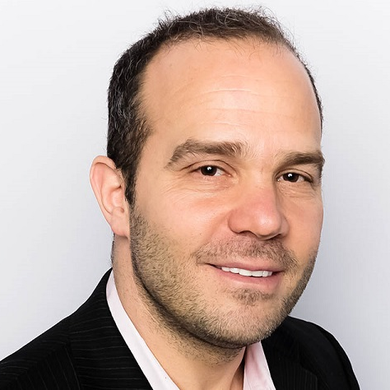
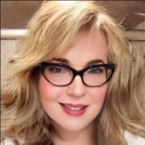
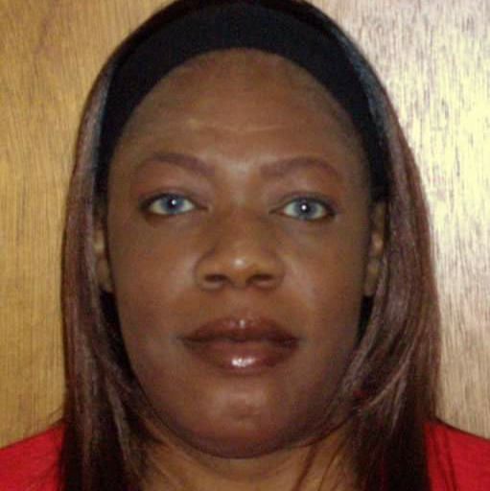
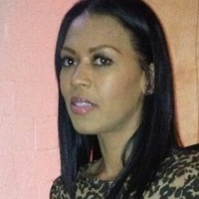
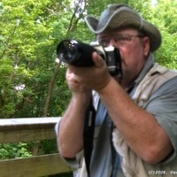
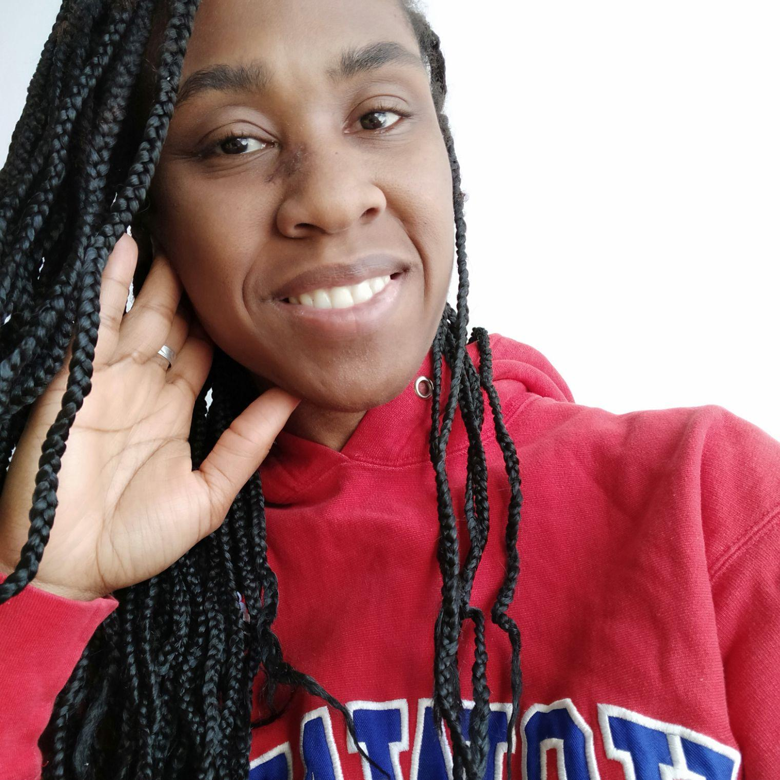


Meet our Team
Rob Camhi
Charlsey Duran
Monica Jackson
Summer Ranaldson
Paul M. Summitt
Akilah Witherspoon
TEAM MEMBER
TEAM MEMBER
TEAM MEMBER
TEAM MEMBER
TEAM MEMBER
TEAM MEMBER

Slide 3
Rob Camhi
Review Task 4
Highly motivated and supportive figure was there every step of the way to cheer on and help the team! Looking forward to the presentation – Let's Go Team! Everyone’s BSMs and Technical Ability will be Shining Tonight - Thumbs-Up! I must commend my team for the job well-done and the experiences we all had throughout the process. Paul you’re the best - thank you for taking on tremendous responsibility & making it all possible! Summer thank you for staying up late to teach me Figma! Charlsey & Monica thank you for keeping the energy flowing and directing traffic! We couldn’t do it without our fearless leader who kept everything organized and everyone in check thank you Akilah! Team 3 is ready :-))

Slide 4
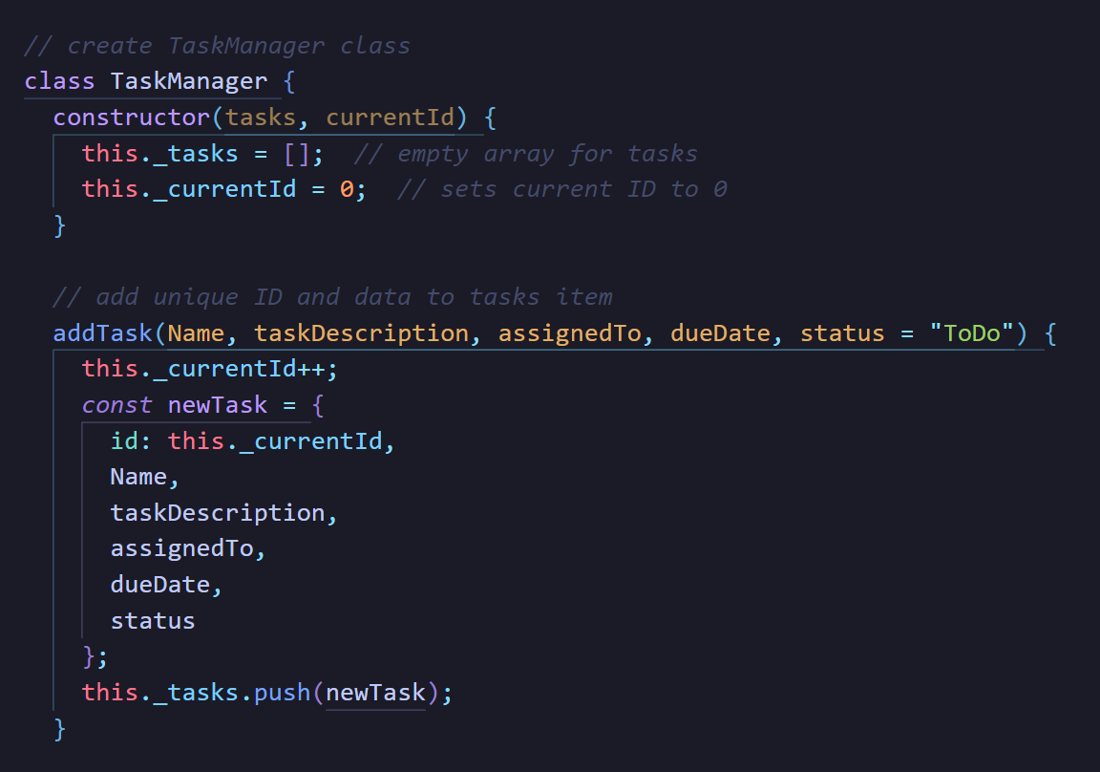
Charlsey Duran
Figure 1: Task 5 Example
Figure 2: Favicon and Logo
Review Task 5
Task 5 required the use of classes in JavaScript. I learned that the concept of a class was introduced in ECMA6. Classes are considered “syntactic sugar,” because they give a cleaner syntax for executing the function constructor and enabling prototypal inheritance. There are two ways to use a class, class declaration or class expression. Our project uses class declaration for our Task Manager. Unlike functions, classes must be defined before they can be called. They are a blueprint and make it possible to create an instant constructor, which is an instance of the class object and has inheritance capabilities. (Figure 1).

Slide 5
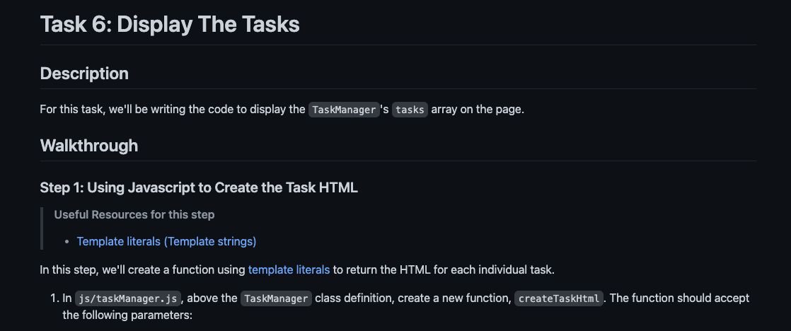
Monica Jackson
Review Task 6
I would like to thank everyone on my team for helping me get through this project. Akilah, Paul, Summer, Charlsey and Rob. Thank you guys for being wonderful team mates I couldn’t have done it without you.

Slide 6
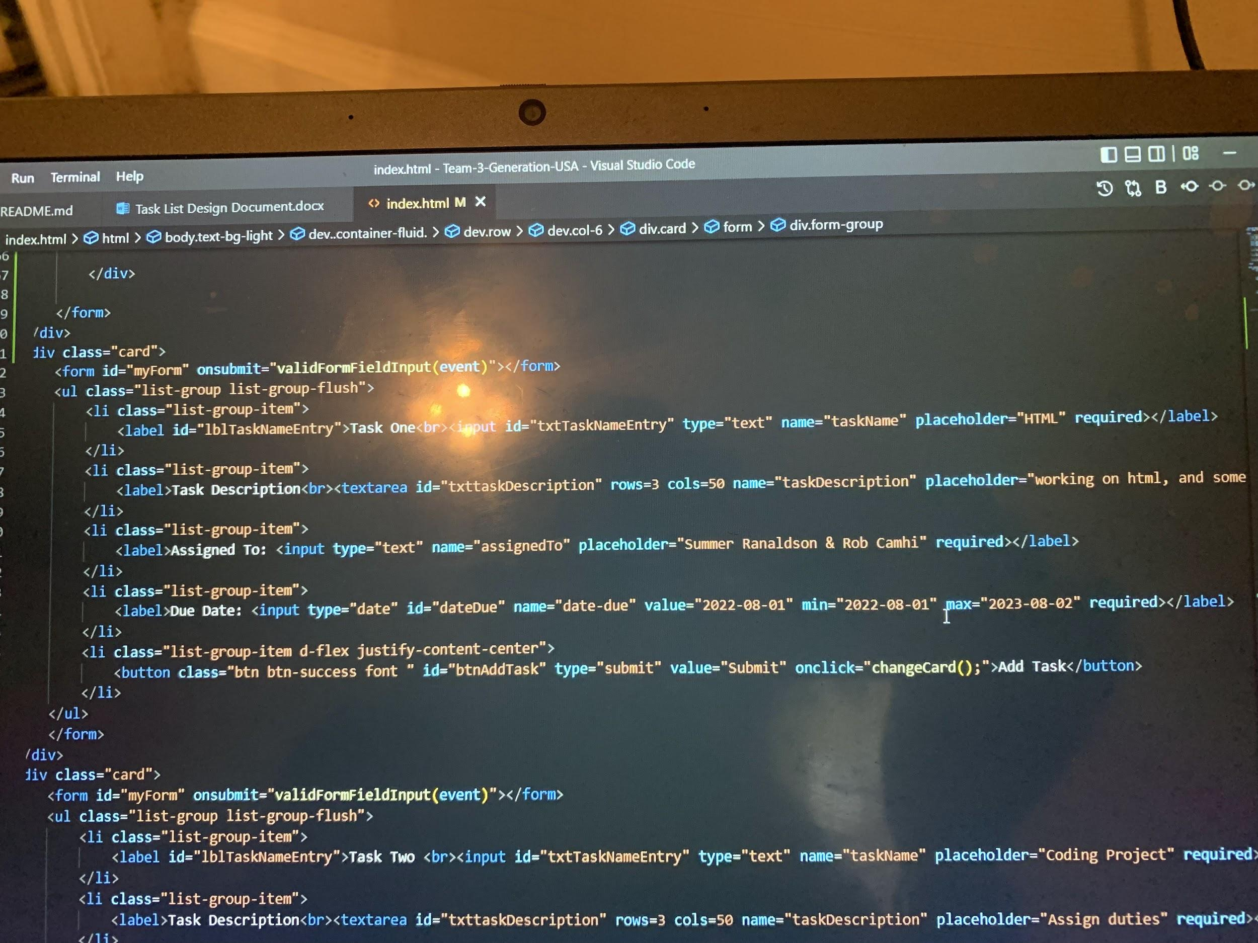
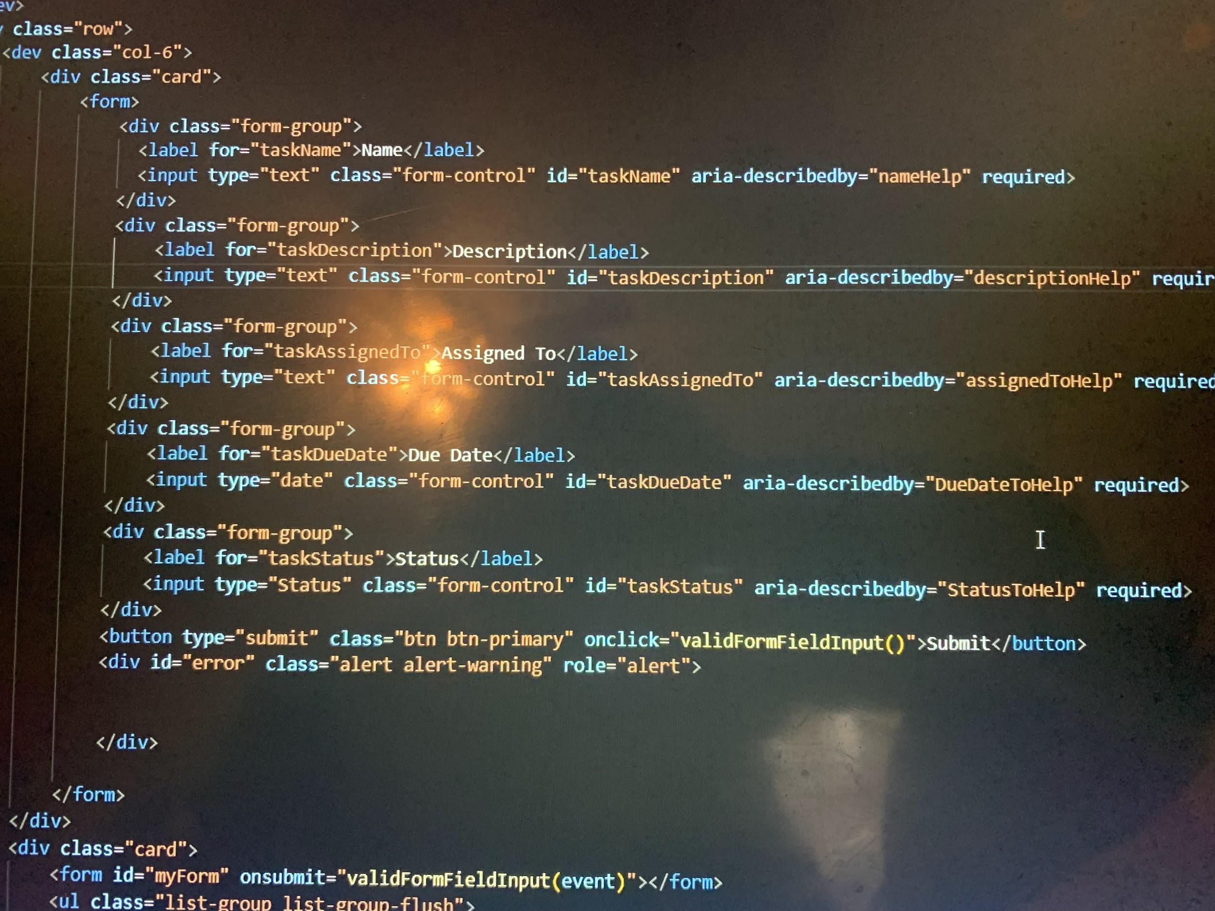
Summer Ranaldson
Figure 1: Image of Task 3 HTML5
Figure 2: Task 6
Task 3: Create a Task Card layout and a task list component
This is the code I created due to the git push problems we encountered we amended the code to make the project work properly.
Task 6: (Monica and I) Task Form Inputs Validation

Slide 7
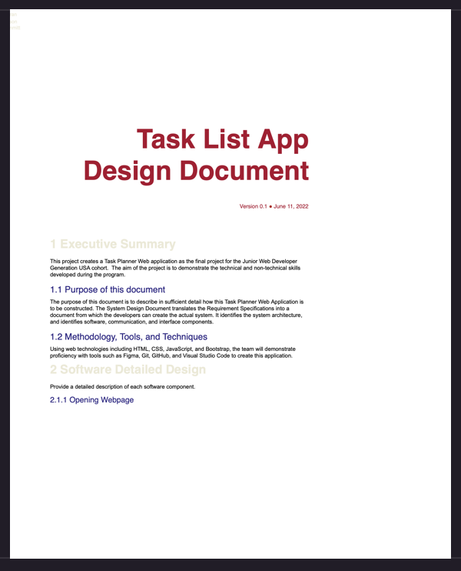
Paul M. Summitt
Provided technical support to the team. Tried to be there when they needed assistance. Produced a Task List App Design Document + Guide which is available on our Git repository.

Slide 8
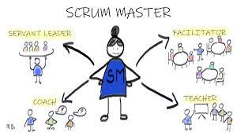
Akilah Witherspoon
Review Task 4
Team Lead
Merge Pull Requests
Published Web App to GitHub

Slide 9
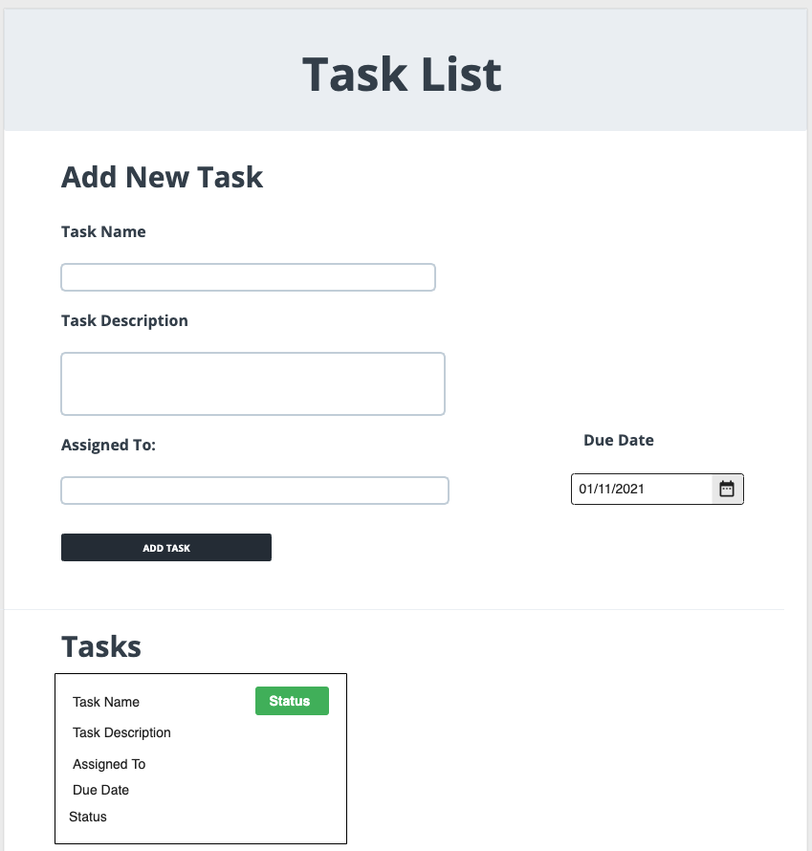
Project Background
For this project we were tasked with creating a Task Planner web app from scratch.
We were to demonstrate the skills learned over the course of the Junior Web Developer program.
There were 10 tasks broken up into 3 sprints.

Slide 10
The 10 Tasks
Task 1: Design your App Wireframes
Task 2: Implement your Wireframes using Bootstrap
Task 3: Create a Task Card layout and a Task List component
Task 4: Task Form Inputs Validation
Task 5: Adding Tasks
Task 6: Display The Tasks
Task 7: Update A Task
Task 8: Persisting Tasks to LocalStorage
Task 9: Deleting Tasks
Task 10: Test TaskManager

Slide 11
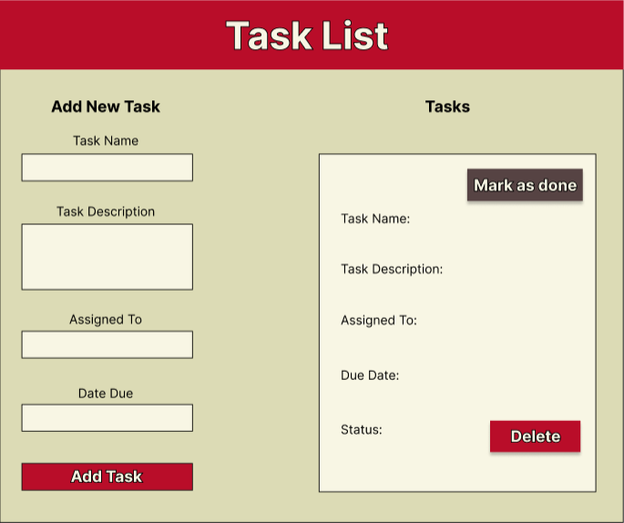
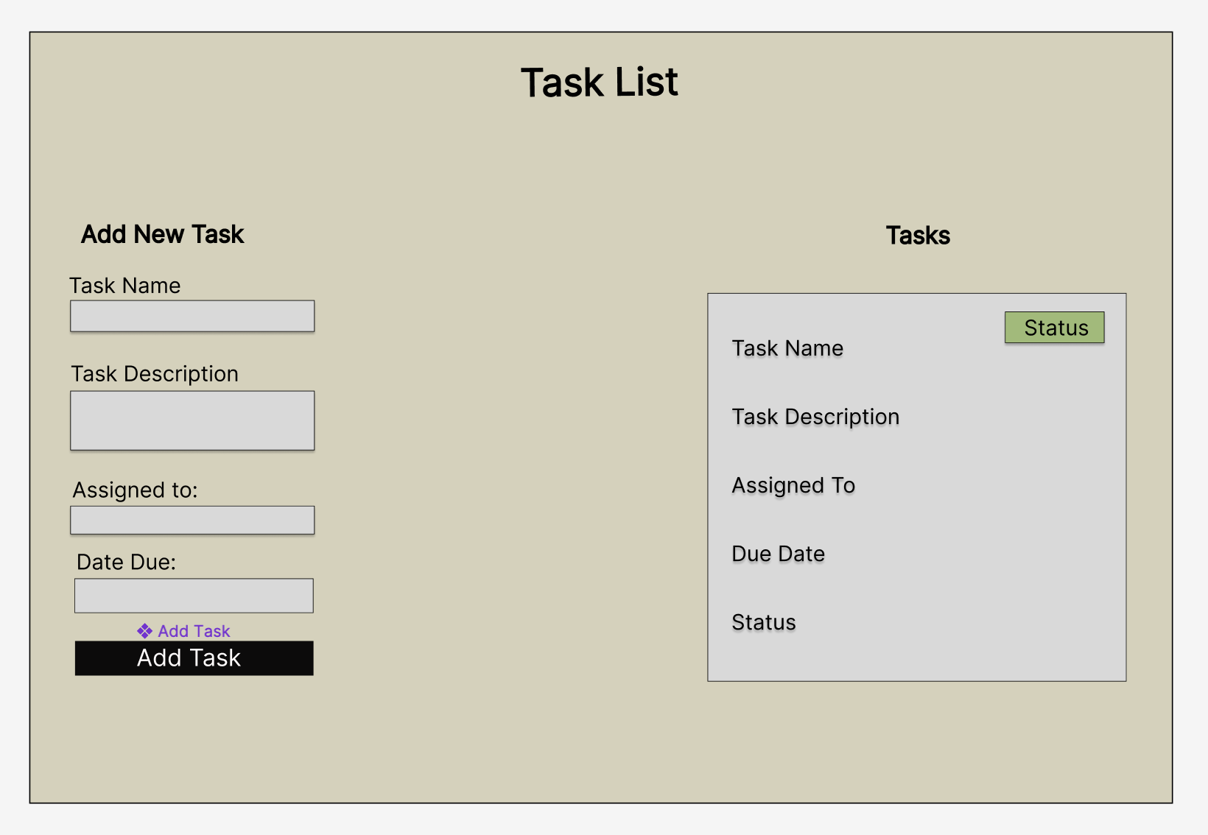
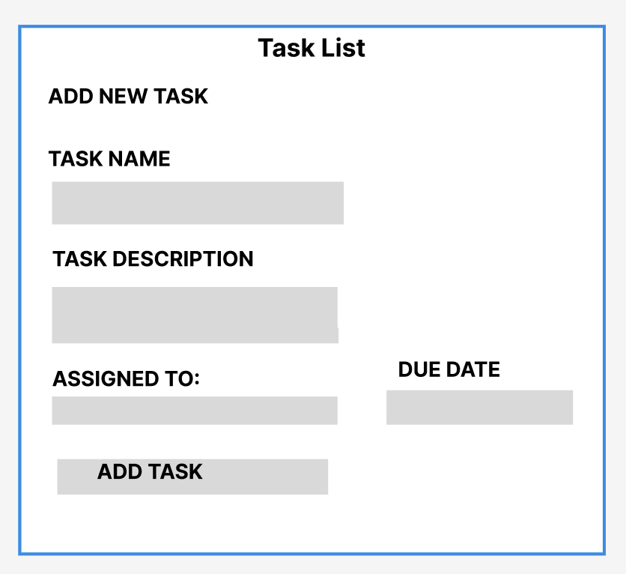
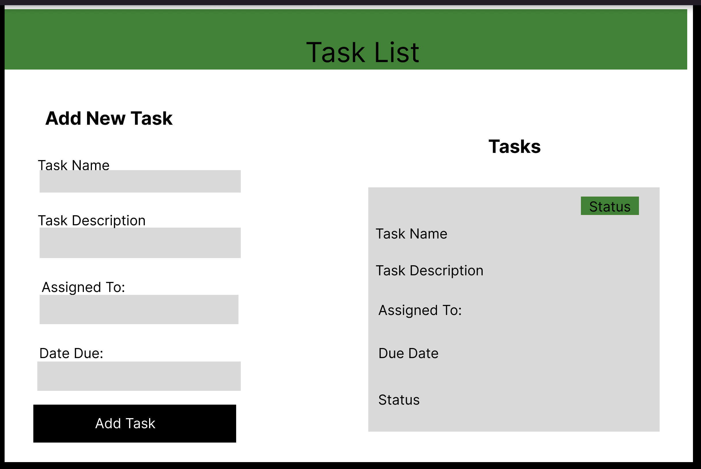
Our Wireframe
Charlsey Duran
Rob Camhi
Summer Ronaldson
Notes:
Each of us did our own wireframes so that we knew how to do it.

Slide 12



Core Technologies
Design Tools
Figma
VS Code
GitHub
Photoshop
Favicon Converter
Programming Tools/ Languages
HTML
CSS
JavaScript
Bootstrap
Notes:
Charlsey A favicon is an icon displayed in the browser address bar. Ours was created in Adobe Photoshop and converted with the following site. https://favicon.io/favicon-converter/.
Summer Problems encountered: The branch wasn’t created properly and I clone the project instead of Akilah team project initially.

Slide 13
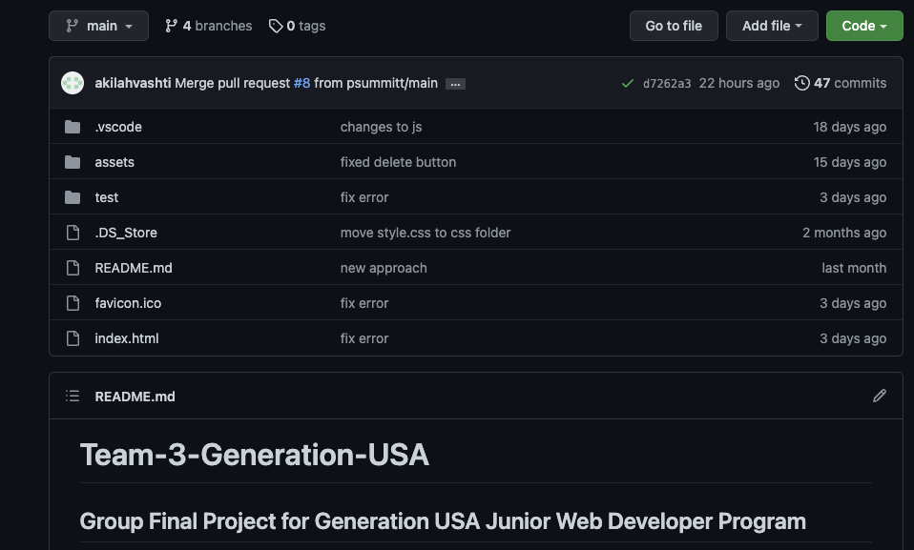
Our Repository

Slide 14
Challenges And Positives
Positives
As team able to put project first and adapt and work together
Team members have various skill sets
Challenges
Technology issues
Testing
Receiving coding from other team members
Not understanding how to use the branches correctly at first

Slide 15
Challenges And Positives
“
“We initially ran into challenges. The Github branch was not created correctly. We discovered that working within Github was a bit more challenging than we thought. However, a growth mindset helped us resolve this issue through trial and error, and the branch was successfully modified. Our favicon is added in the <head> tag of our HTML document, and our icon is also used as a logo in our presentation on our master slide. ” Charlsey
“Problems encountered: The branch wasn’t created properly and I clone the project instead of Akilah team project initially.” Summer onTask 3

Slide 16
Task Manager Demonstration

